Slide 1
Input/Output
Chapter 5
5.1 Principles of I/O hardware
5.2 Principles of I/O software
5.3 I/O software layers
5.4 I/O devices: Disks,
Character-oriented terminals,
Clocks

Slide 2
5.1 Principles of I/O hardware

Slide 3
Principles of I/O Hardware
Types of I/O devices
Two main groups: Block and Character Devices
Block devices include disk drives
  Commands include read, write, seek
  Raw I/O or file-system access
  Memory-mapped file access possible
Character devices include keyboards, mice, serial ports
  Commands include get, put
  Libraries layered on top allow line editing

Slide 4
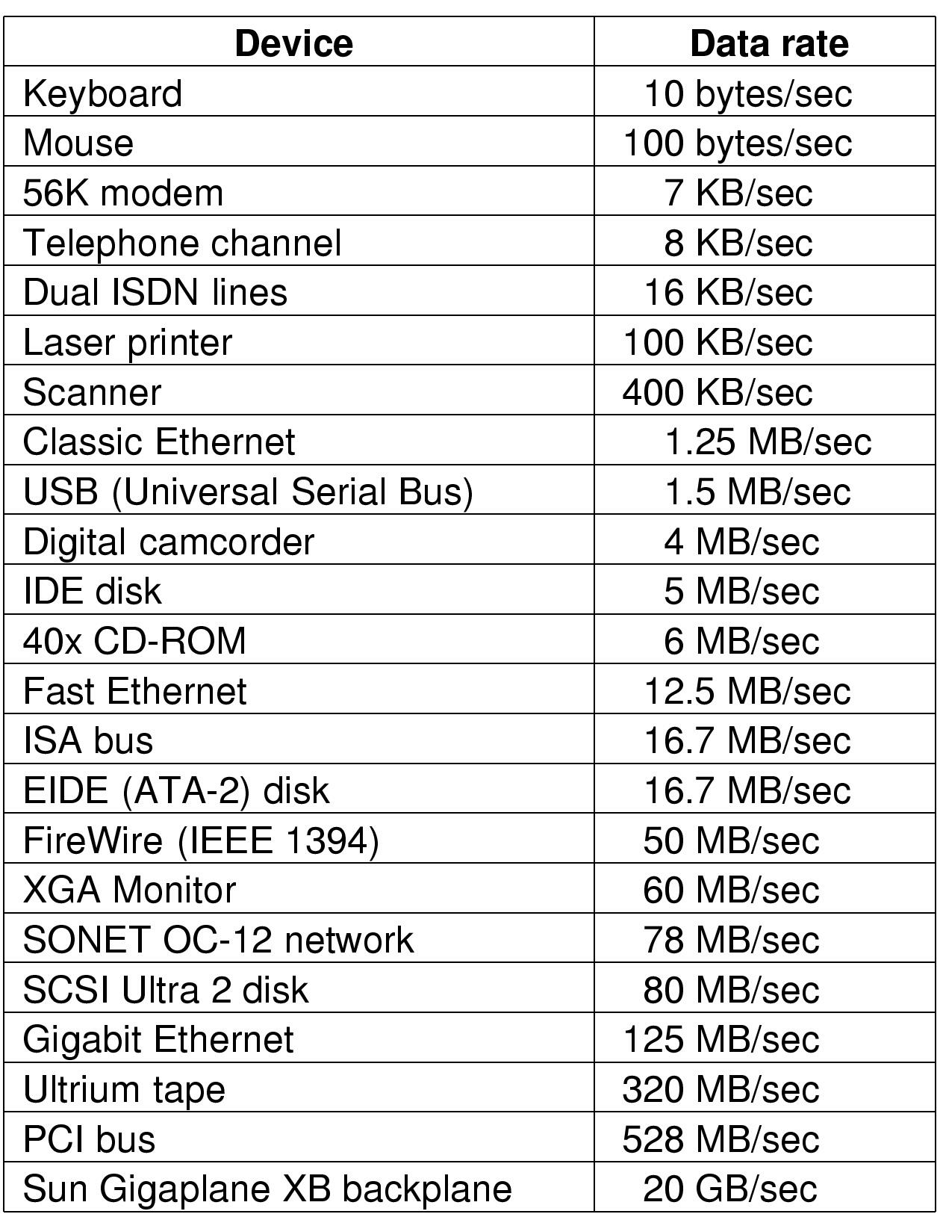
Principles of I/O Hardware
Types of I/O devices
Some typical device, network, and data base rates

Slide 5
Principles of I/O Hardware
Common concepts
Common concepts
  I/O Device Controller
  I/O Port
  I/O Bus

Slide 6

Principles of I/O Hardware
Device Controllers
Monitor
Bus
Components of a simple personal computer

Slide 7
Principles of I/O Hardware
Device Controllers
I/O devices have components:
  electromechanical component
  electronic component
The electronic component is the device controller
  may be able to handle multiple devices
Controller's tasks (Disk)
  convert serial bit stream to block of bytes
  perform error correction as necessary
  make available to main memory

Slide 8
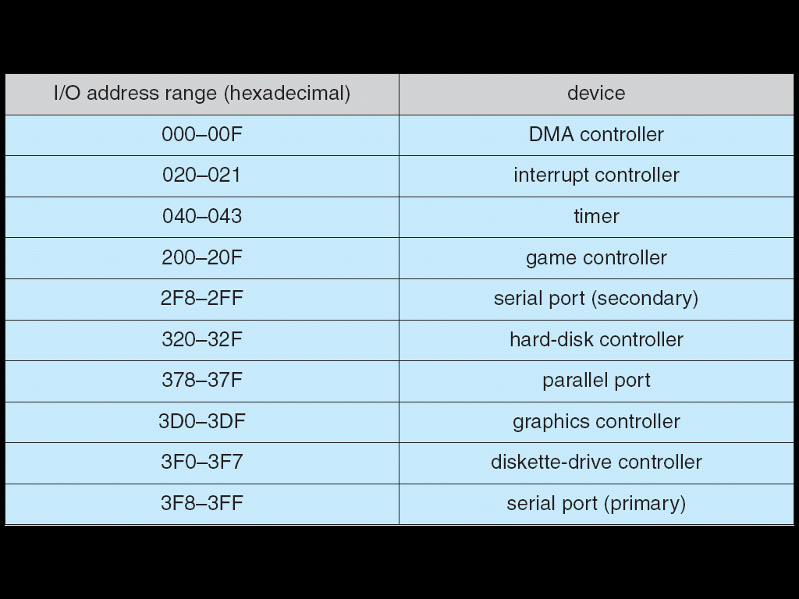
Principles of I/O Hardware
I/O Port
I/O Port is a register in device interface. Example: Device I/O Port Locations on PCs (partial)

Slide 9

Principles of I/O Hardware
A Typical PC Bus Structure

Slide 10
Principles of I/O Hardware
I/O address
I/O instructions control devices
Devices have addresses, used by
  Direct I/O instructions
  Memory-mapped I/O

Slide 11
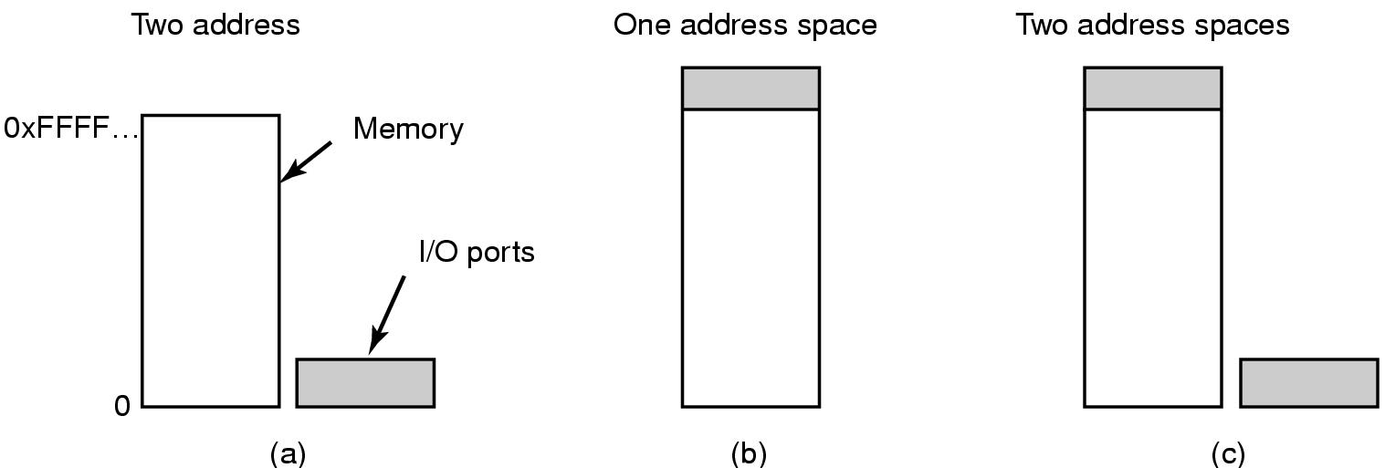
Principles of I/O Hardware
Memory-Mapped I/O (1)
Separate I/O and memory space
Memory-mapped I/O
Hybrid

Slide 12
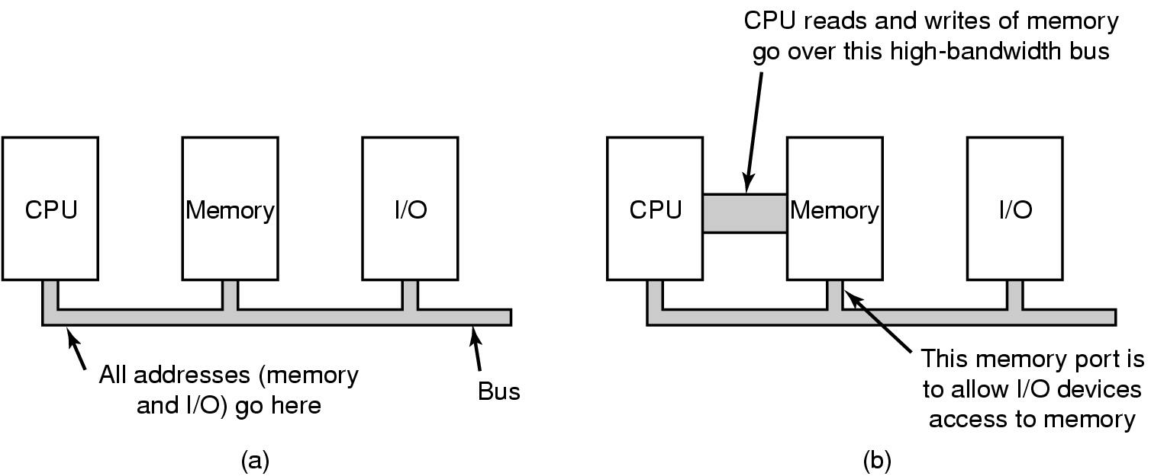
Principles of I/O Hardware
Memory-Mapped I/O (2)
(a) A single-bus architecture
(b) A dual-bus memory architecture

Slide 13
Principles of I/O Hardware
Data transfer Method between CPU and I/O device
Three Data I/O transfer Methods:
Programmed I/O
Interrupt-Driven I/O
Direct Memory Access - DMA

Slide 14
Principles of I/O Hardware
Programmed I/O, Polling
Determines state of device
  ready
  busy
  error
Busy-wait cycle to wait for I/O from device

Slide 15

Principles of I/O Hardware
Interrupt-Driven I/O
How interrupts happens. Connections between devices and interrupt controller actually use interrupt lines on the bus rather than dedicated wires

Slide 16
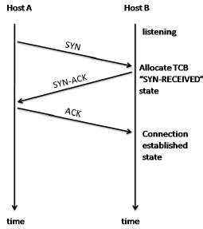

Slide 17
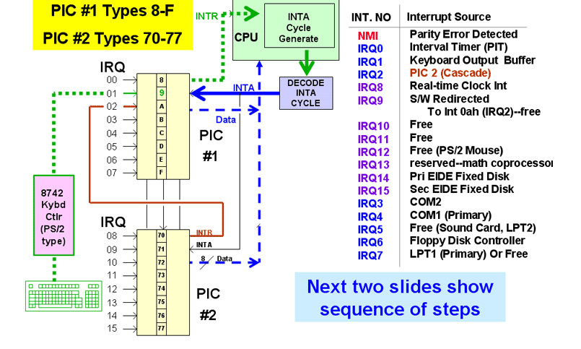
Principles of I/O Hardware
Example: Interrupts of PC computer

Slide 18

Principles of I/O Hardware
Direct Memory Access (DMA)
Operation of a DMA transfer

Slide 19

Principles of I/O Hardware
Example: DMA Transfer in PC Computer

Slide 20
5.2 Principles of I/O software

Slide 21
Principles of I/O Software
Goals of I/O Software (1)
Device independence
  programs can access any I/O device
  without specifying device in advance
    (floppy, hard drive, or CD-ROM)
Uniform naming
  name of a file or device is a string or an integer
  not depending on which machine
Error handling
  handle as close to the hardware as possible

Slide 22
Principles of I/O Software
Goals of I/O Software (2)
Synchronous vs. asynchronous transfers
  blocked transfers vs. interrupt-driven
Buffering
  data coming off a device cannot be stored in final destination
Sharable vs. dedicated devices
  disks are sharable
  tape drives would not be

Slide 23
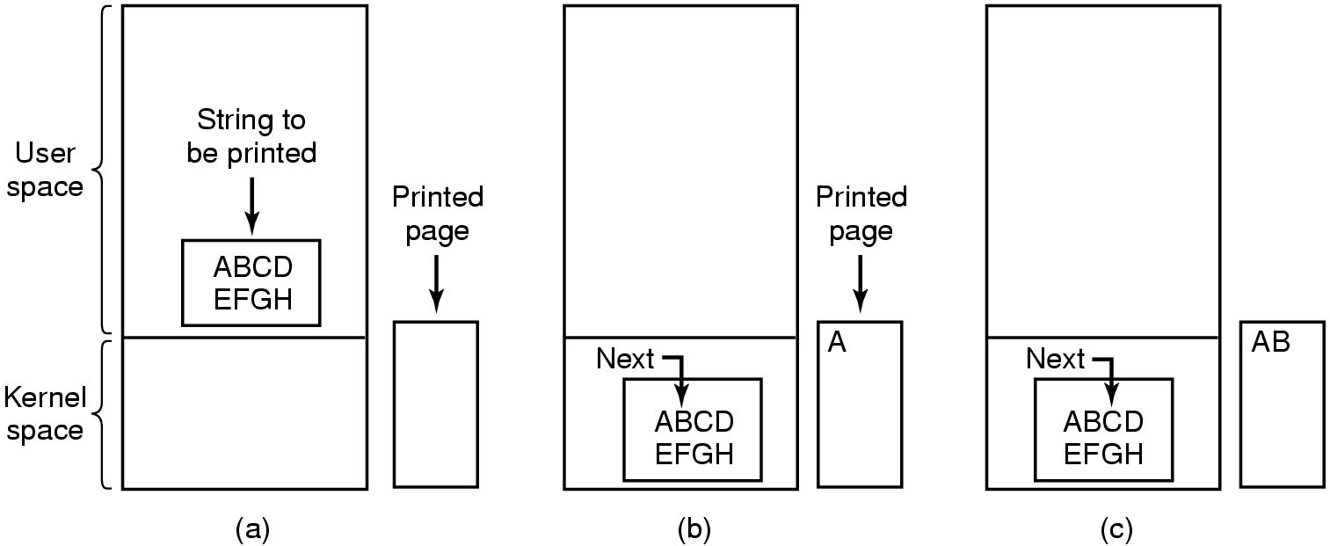
Principles of I/O Software Programmed I/O (1)
Steps in printing a string

Slide 24
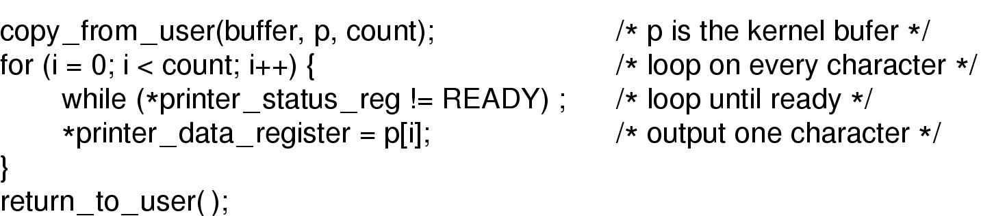
Principles of I/O Software Programmed I/O (2)
Writing a string to the printer using programmed I/O

Slide 25
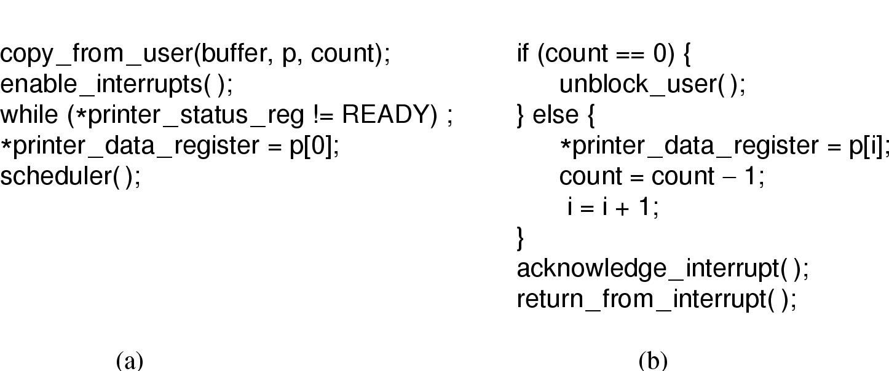
Principles of I/O Software Interrupt-Driven I/O
Writing a string to the printer using interrupt-driven I/O
  Code executed when print system call is made
  Interrupt service procedure

Slide 26
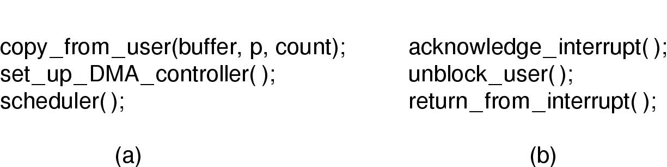
Principles of I/O Software
I/O Using DMA
Printing a string using DMA
  code executed when the print system call is made
  interrupt service procedure

Slide 27
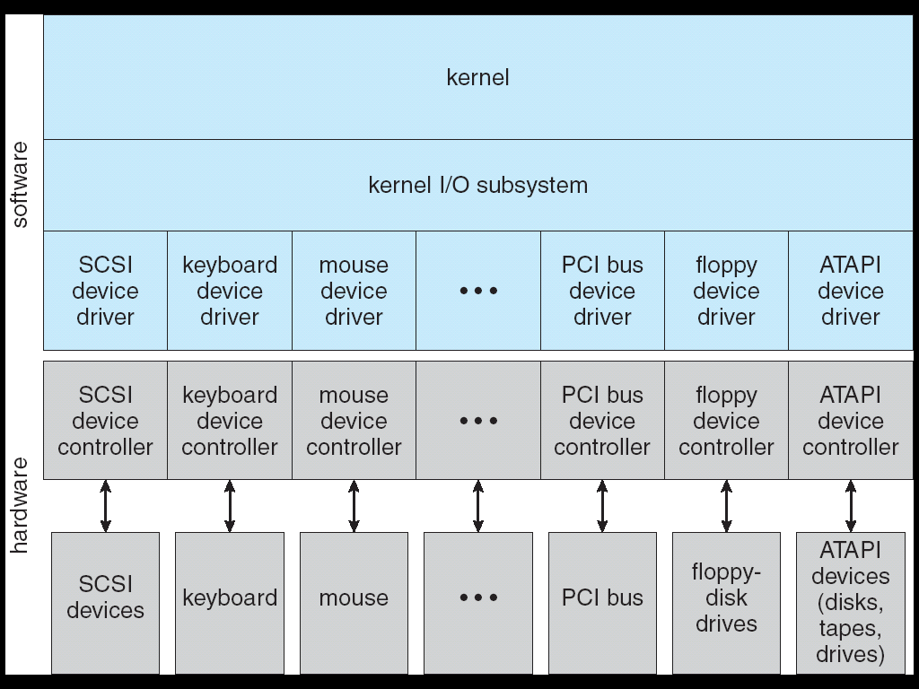
A Kernel I/O Structure:
Hardware And Software

Slide 28
5.3 I/O software layers

Slide 29
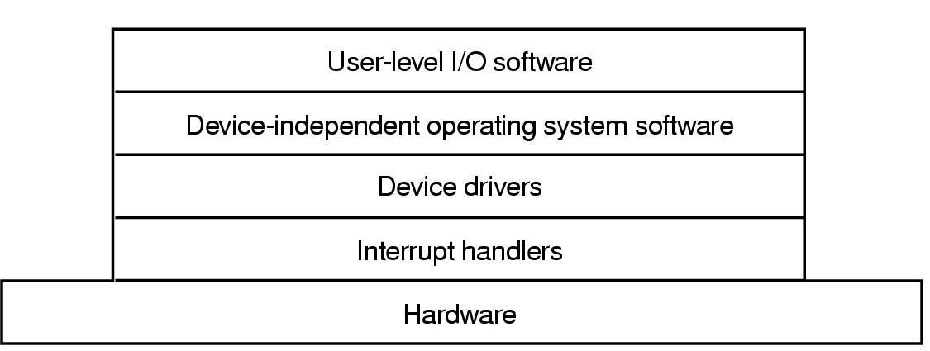
I/O Software Layers
Layers of the I/O Software System

Slide 30
I/O Software Layers
Interrupt Handlers (1)
Interrupt handlers are best hidden
  have driver starting an I/O operation block until interrupt notifies of completion
Interrupt procedure does its task
  then unblocks driver that started it
Steps must be performed in software after interrupt completed
  Save regs not already saved by interrupt hardware
  Set up context for interrupt service procedure

Slide 31
I/O Software Layers
Interrupt Handlers (2)
  Set up stack for interrupt service procedure
  Ack interrupt controller, reenable interrupts
  Copy registers from where saved to process table
  Run service procedure
  Set up MMU context for process to run next
  Load new process' registers
  Start running the new process

Slide 32
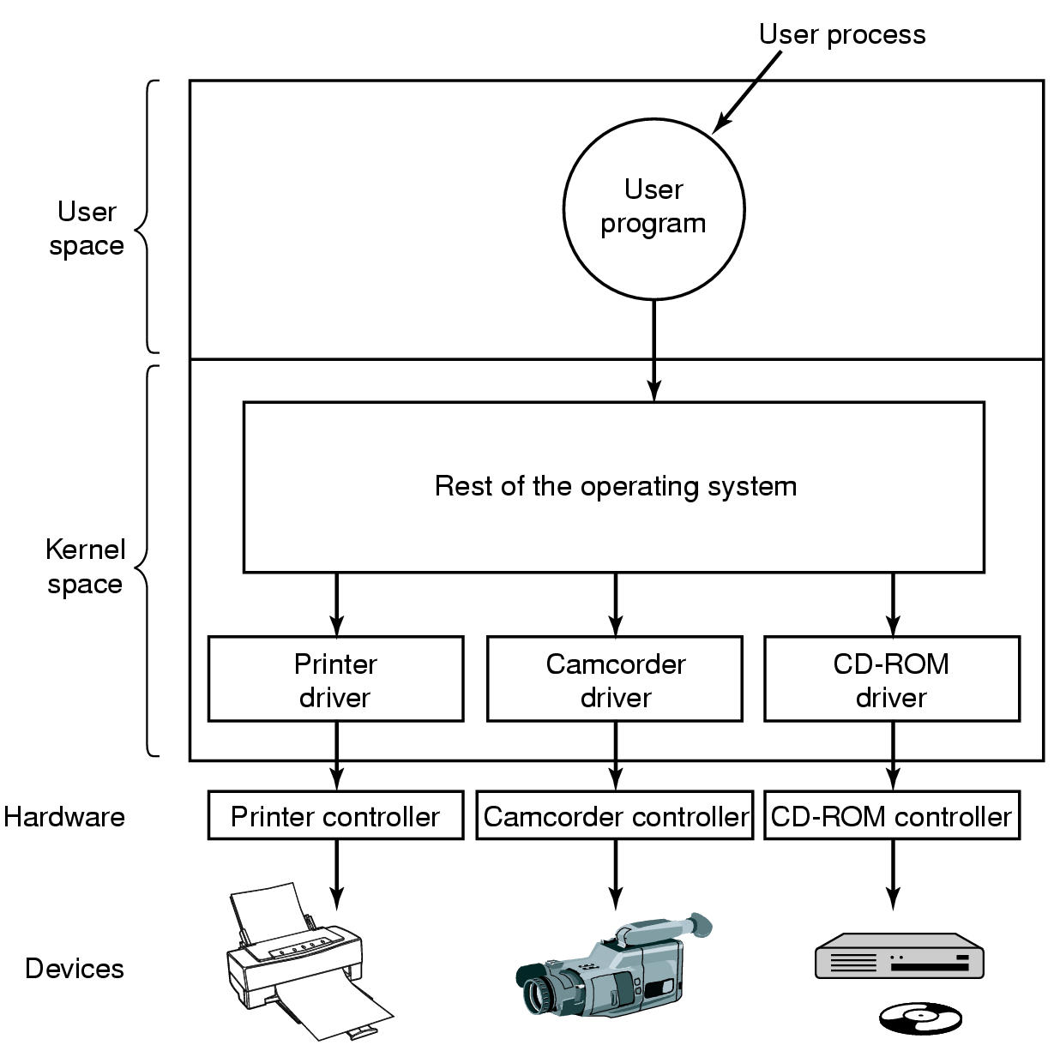
I/O Software Layers
Device Drivers
Logical position of device drivers is shown here
Communications between drivers and device controllers goes over the bus

Slide 33
I/O Software Layers
Device-Independent I/O Software (1)
Uniform interfacing for device drivers
Buffering
Error reporting
Allocating and releasing dedicate devices
Providing a device-independent block size
Functions of the device-independent I/O software

Slide 34
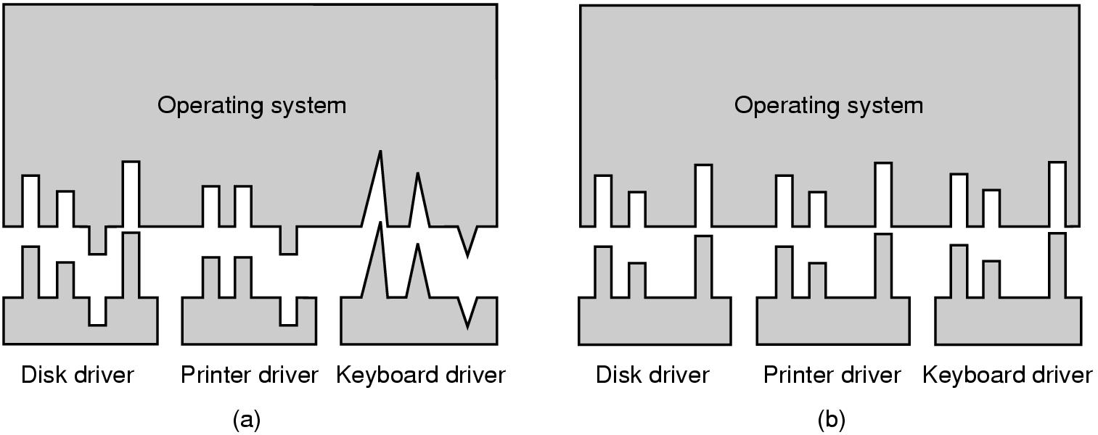
I/O Software Layers
Device-Independent I/O Software (2)
(a) Without a standard driver interface
(b) With a standard driver interface

Slide 35
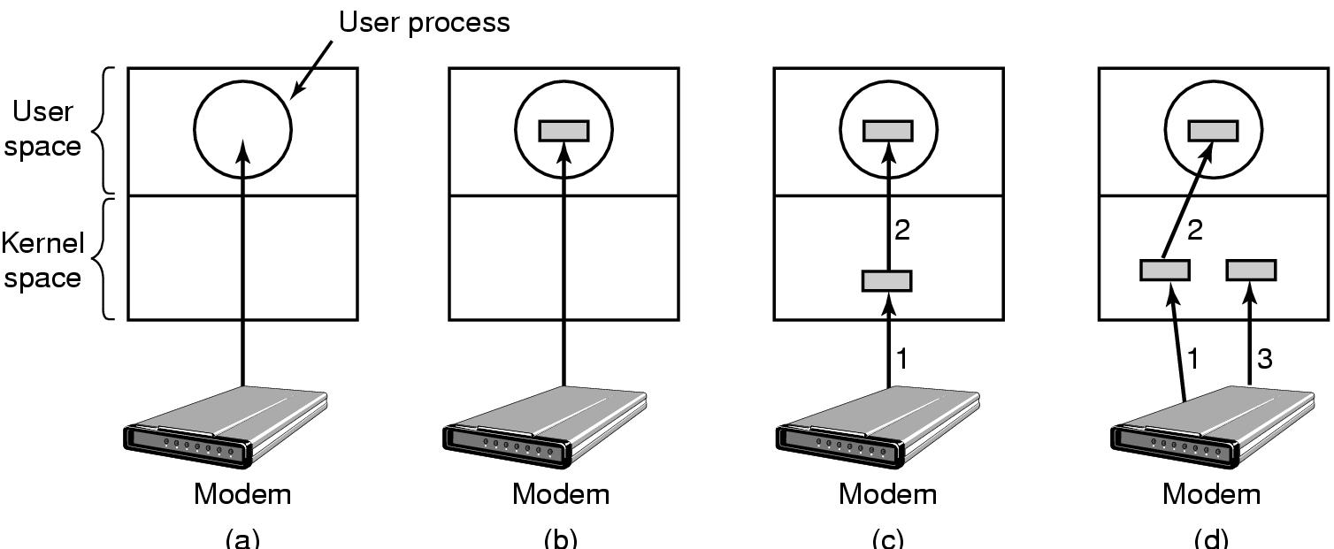
I/O Software Layers
Device-Independent I/O Software (3)
(a) Unbuffered input
(b) Buffering in user space
(c) Buffering in the kernel followed by copying to user space
(d) Double buffering in the kernel

Slide 36
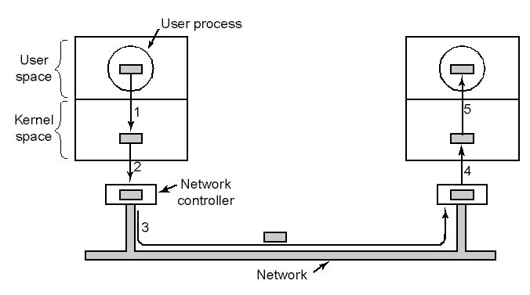
I/O Software Layers
Device-Independent I/O Software (4)
Networking may involve many copies

Slide 37
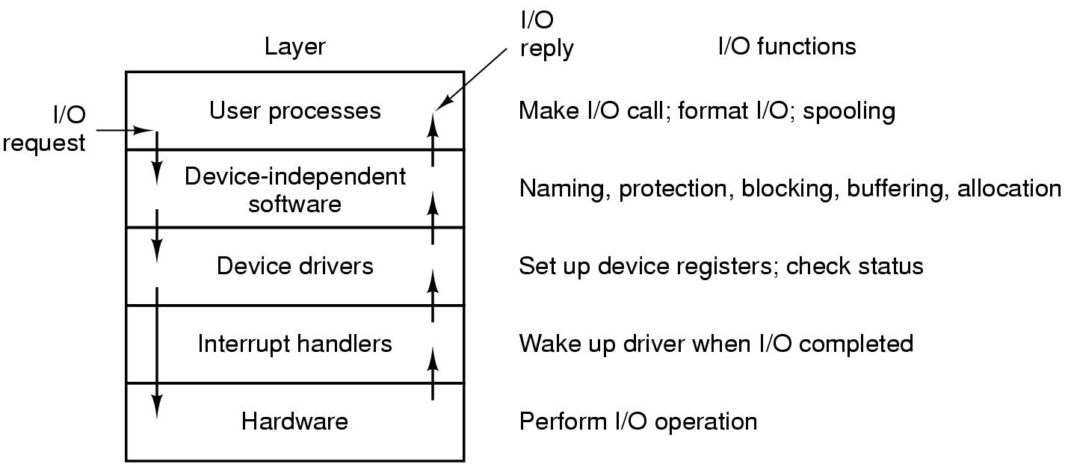
User-Space I/O Software
Layers of the I/O system and the main functions of each layer

Slide 38
5.4 I/O devices

Slide 39
I/O devices
Storage devices: Hard Disks, CD-ROM, CD-R, DVD…
Display devices: Character-oriented terminals, Graphical user interfaces
Clocks

Slide 40
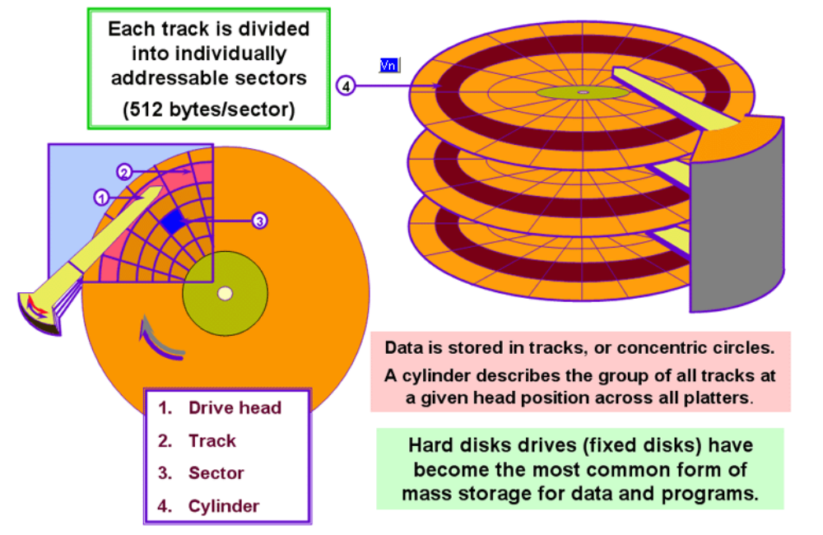
Disk Hardware (1)

Slide 41
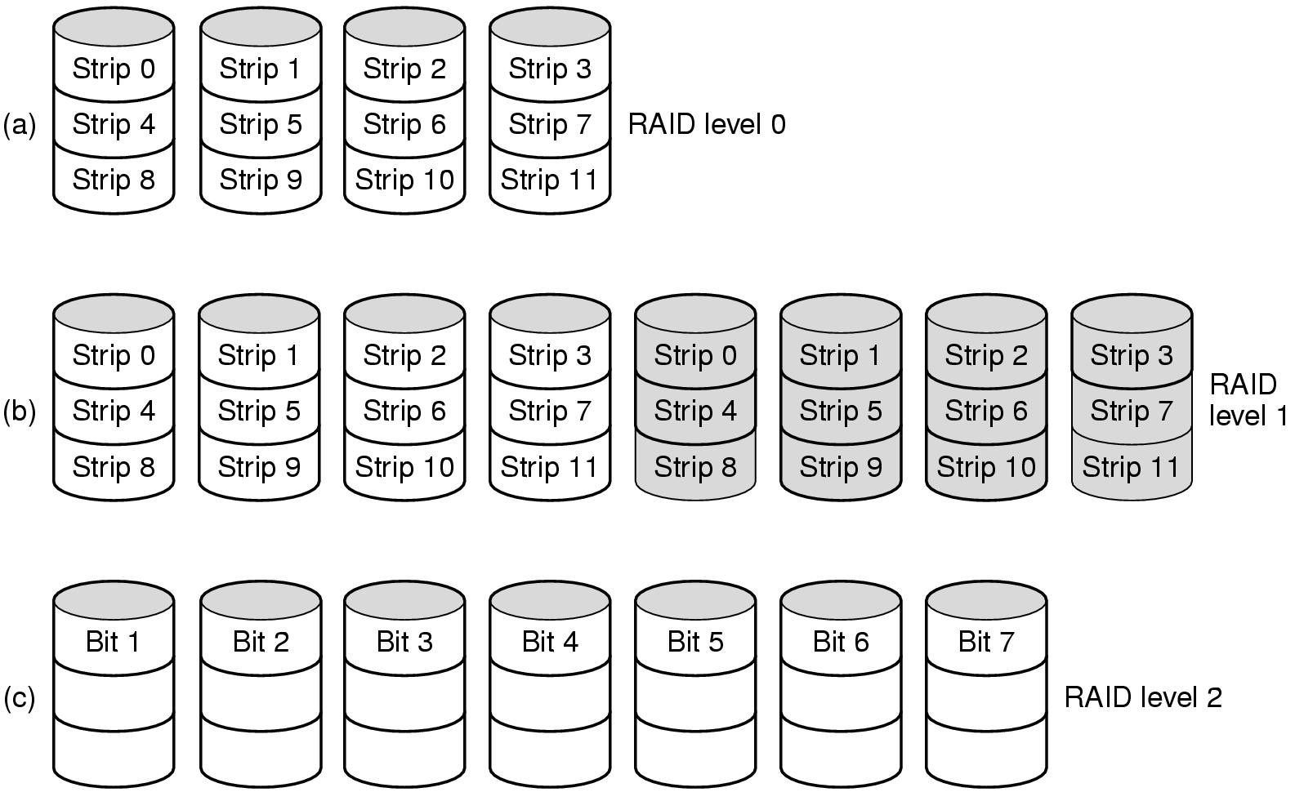
Disk Hardware (2)
Raid levels 0 through 2
Backup and parity drives are shaded

Slide 42
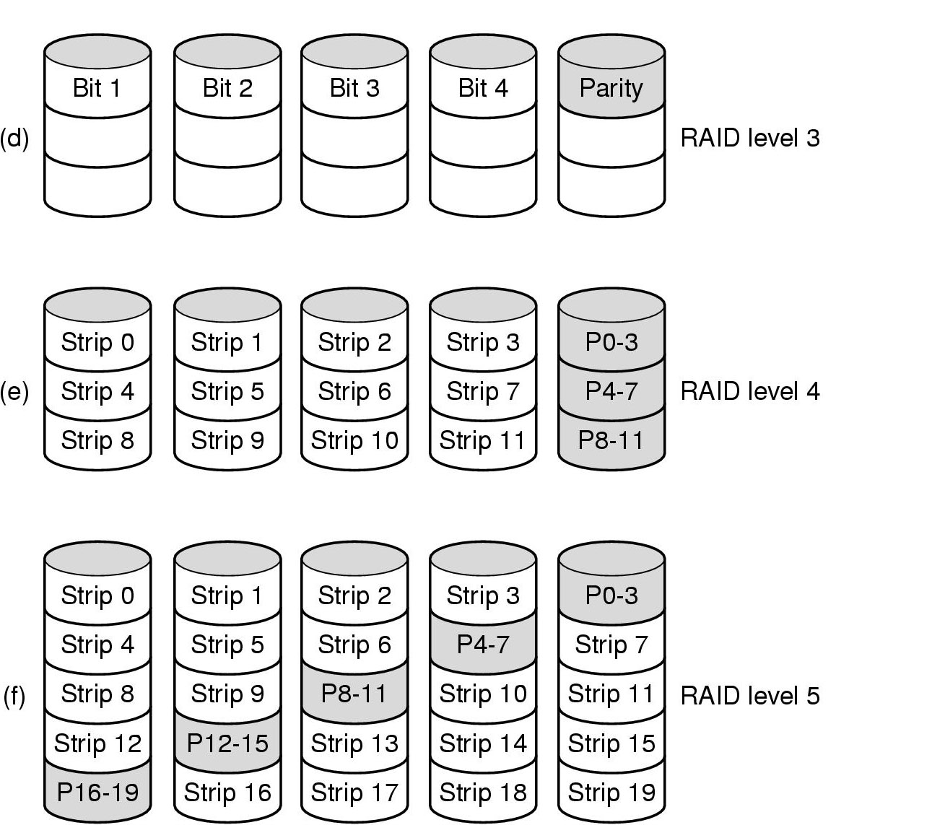
Disk Hardware (3)
Raid levels 3 through 5
Backup and parity drives are shaded

Slide 43
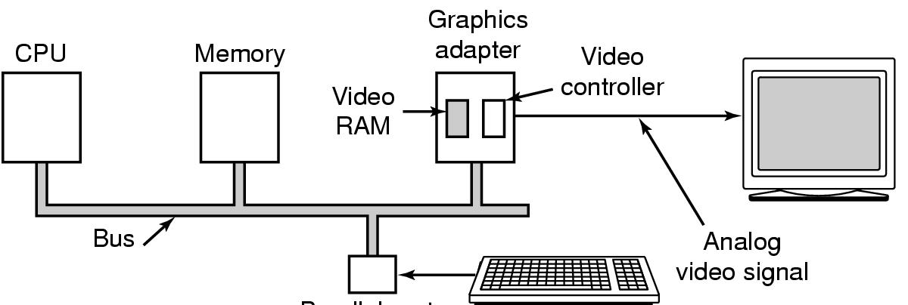
Display Hardware (1)
Parallel port
Memory-mapped displays
driver writes directly into display's video RAM

Slide 44
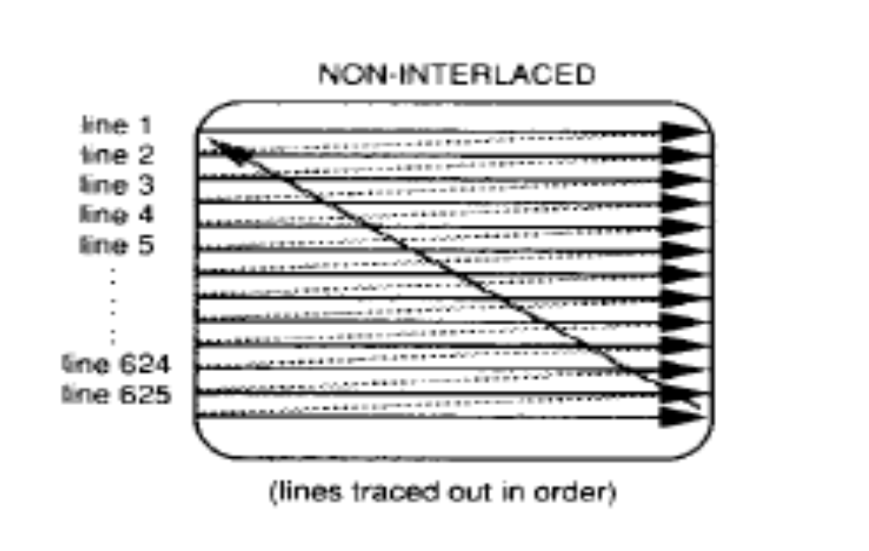
Display Hardware (2)

Slide 45
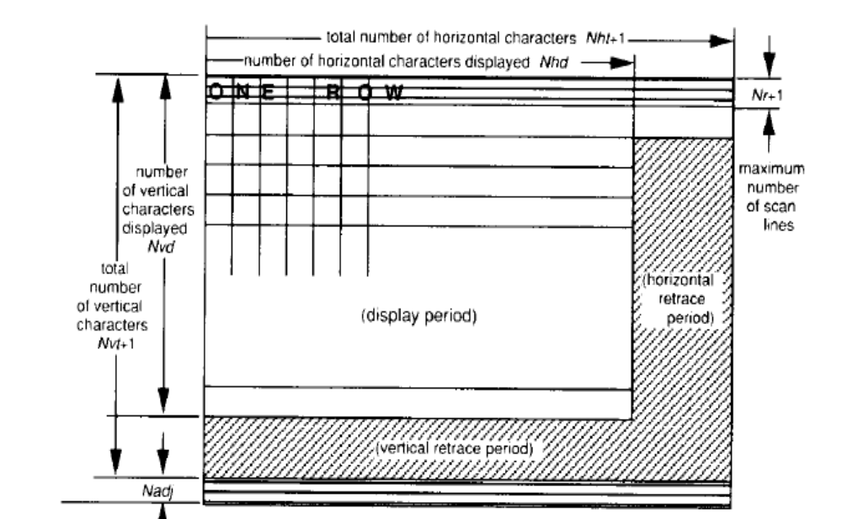
Display Hardware (3)

Slide 46
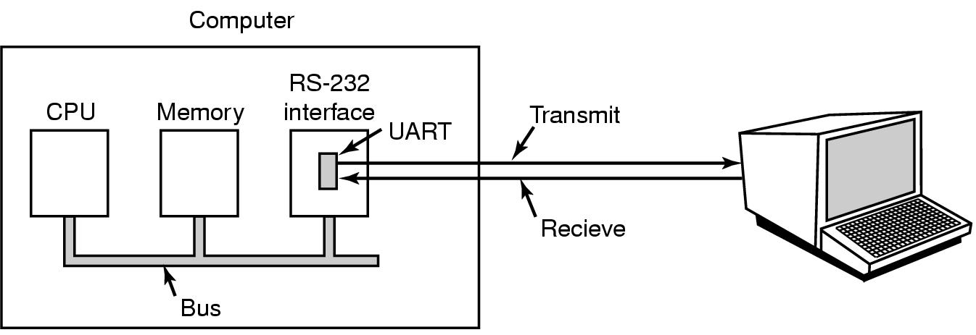
Character Oriented Terminals
RS-232 Terminal Hardware
An RS-232 terminal communicates with computer 1 bit at a time
Called a serial line – bits go out in series, 1 bit at a time
Windows uses COM1 and COM2 ports, first to serial lines
Computer and terminal are completely independent

Slide 47
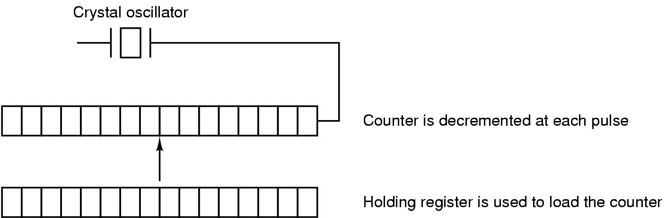
Clocks
Clock Hardware
A programmable clock

